Slide 1

Data Visualization
RAHUL BISWAS
M.sc. Computer Science (Sem – 4)
UNIVERSITY OF CALCUTTA

Slide 2
DATA SET DESCRIPTION
Name : NEET Rank & Score Analysis (2015-2024)
About : This dataset contains NEET (National Eligibility cum Entrance Test) rank and score information for students from 2015 to 2024. The data includes AIR (All India Rank), state ranks, category-wise cutoffs, percentile scores, and total marks obtained.
Source & Author : https://www.kaggle.com/datasets/tanveersinghbedi/neet-rank-and-score-analysis-2015-2024/ ; Tanveer Singh

Slide 3
DATA SET DESCRIPTION (Continued)
Number of Rows : 50000
Column details:
Number of Column : 12
Year – Exam year
Candidate_ID – Unique candidate identifier
Name – Candidate’s name
State – State of domicile
Category – General, OBC, SC, ST, EWS
Total_Score – Total marks obtained out of 720
Percentile – Percentile score
AIR(All India Rank) – Overall rank in India
State_Rank – Rank within the state
Category_Rank – Rank within the category
Qualified_Status – Yes/No
Cutoff_Score – minimum qualifying marks

Slide 4
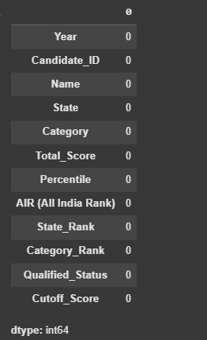
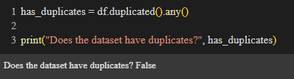
DATA CLEANING
Checking for Null Value:
Checking for duplicate values:
* The dataset does not have any derived attributed as well.
Rahul Biswas ( University of Calcutta)
13-Feb-25
1

Slide 5
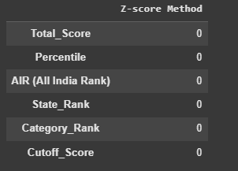
DATA CLEANING(Continued)
Find outliers (Z Score method):
* The data set is cleaned.
Rahul Biswas ( University of Calcutta)
13-Feb-25
5

Slide 6
RESULTS

Slide 7
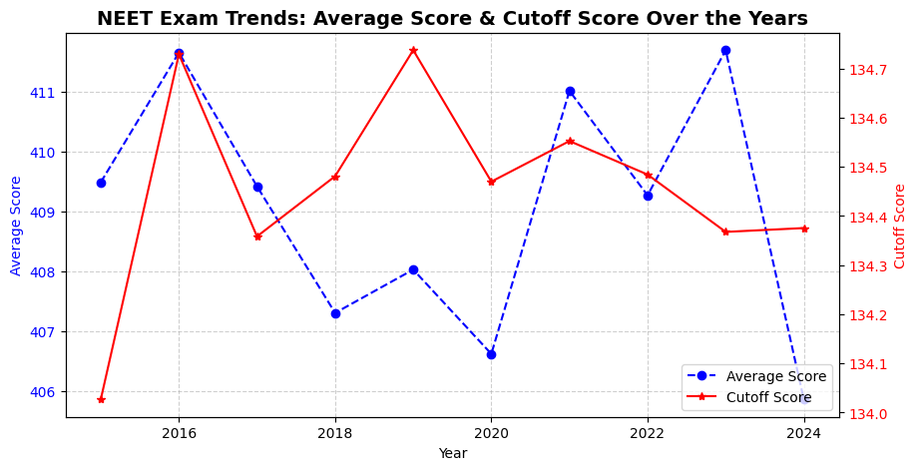
Average Score & Cutoff Score over the years

Slide 8
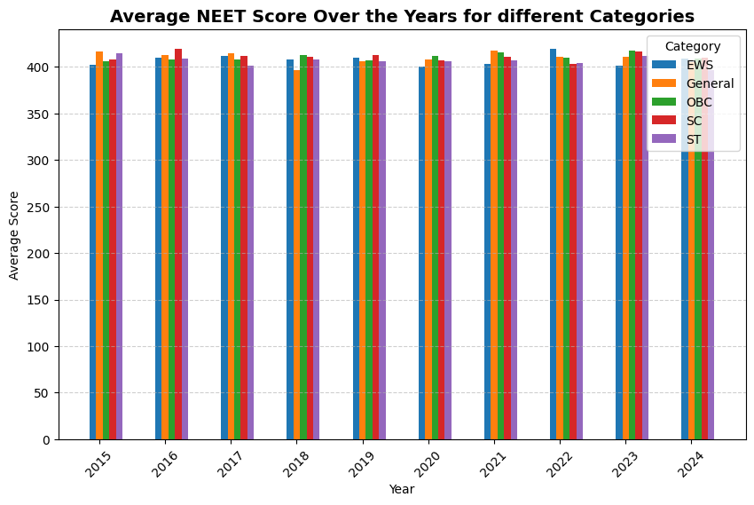
Average Score for Different Categories

Slide 9
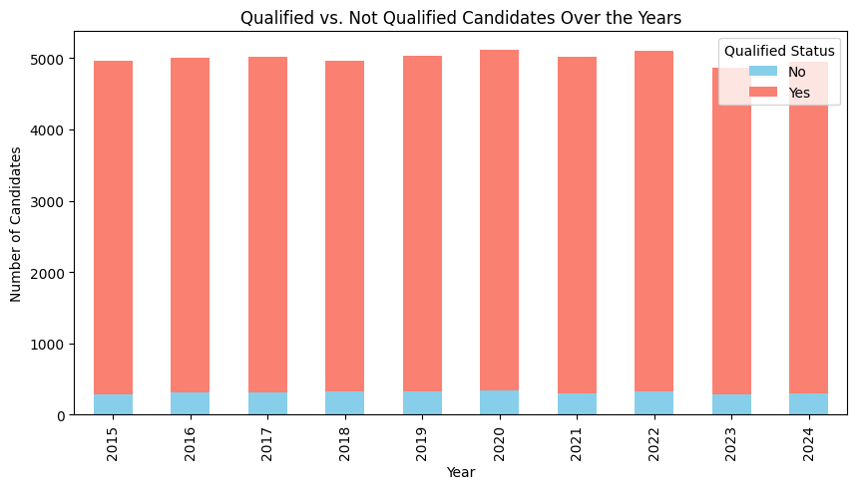
Number of Candidates Qualified vs Not Qualified Over Years

Slide 10
Thank you !!

